Slide 1
Strip Pooling:
Rethinking Spatial Pooling for Scene Parsing
Qibin Hou¹ Li Zhang² Ming-Ming Cheng³ Jiashi Feng¹
¹National University of Singapore
²University of Oxford
³CS, Nankai University
CVPR 2020
Speaker: Cong Fang

Slide 2
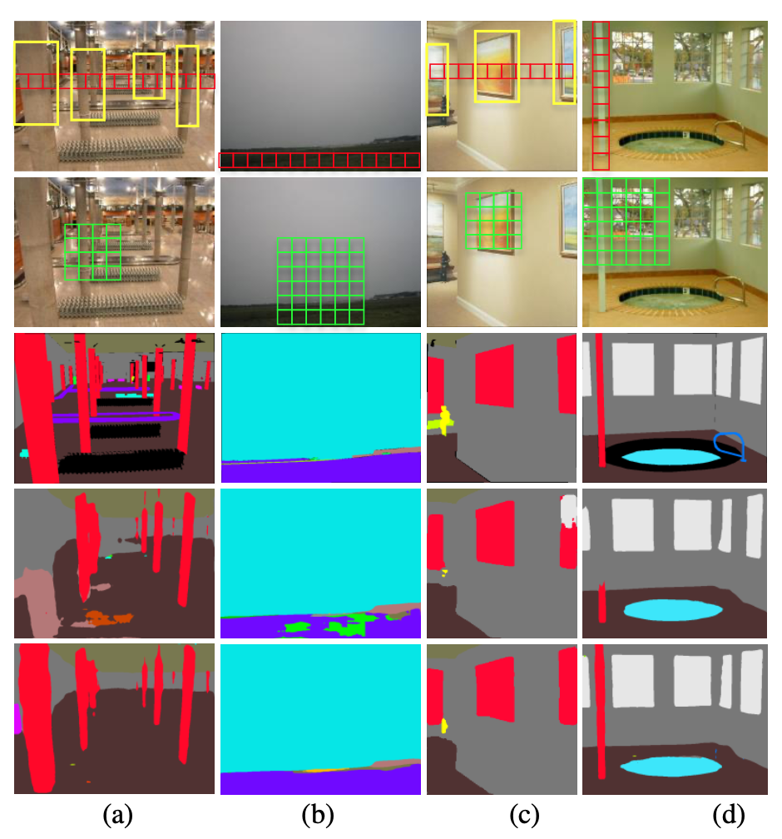
Motivation
FCNs based methods mostly stack local convolutional and pooling operations have limited effective fields-of-view.
Self-attention or non-local modules consume huge memory for computing the large affinity matrix at each spatial position.
Dilated convolutions and pooling probe the input features map within square windows, thus incorporating contaminating information from irrelevant regions.

Slide 3
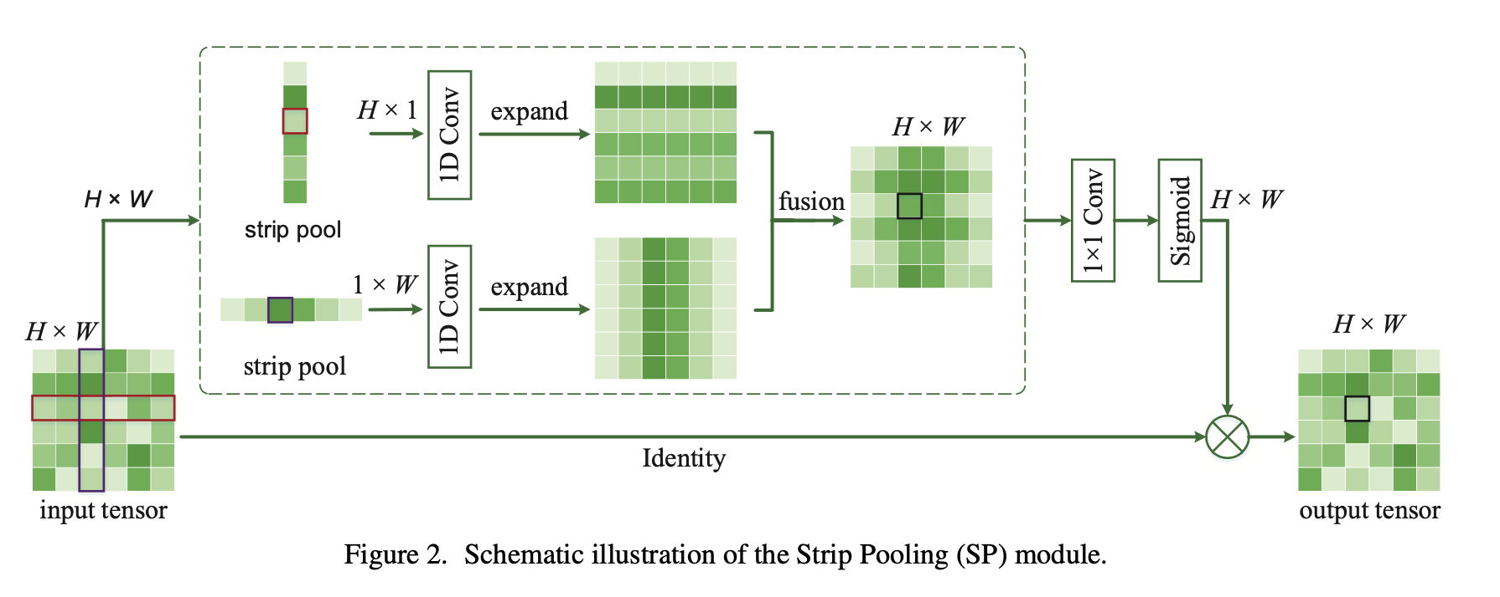
Contributions
kernel size 3
Strip Pooling Module (SPM)

Slide 4
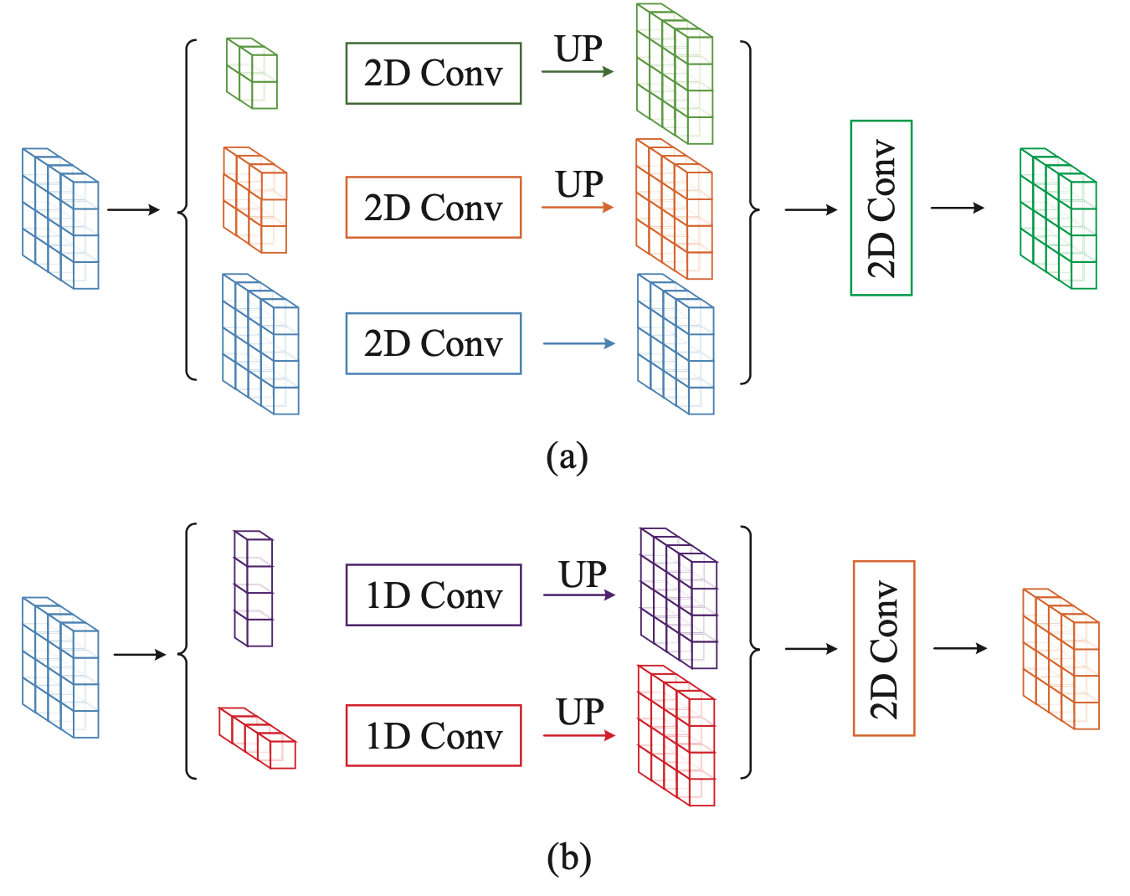
Method
kernel 3*3
12 × 12
20 × 20
summation
1024 channels
256 channels
1024 channels
kernel size 3
Mixed Pooling module (MPM)

Slide 5
Method
Overall Architecture
We improve the original ResNet with the dilation strategy and the final feature map size is set to 1/8 of the input image.
The SPMs are added after the 3 × 3 convolutional layer of the last building block in each stage and all building blocks in the last stage.
We first connect a 1 × 1 convolutional layer to the backbone to reduce the output channels from 2048 to 1024 and then add two MPMs.

Slide 6
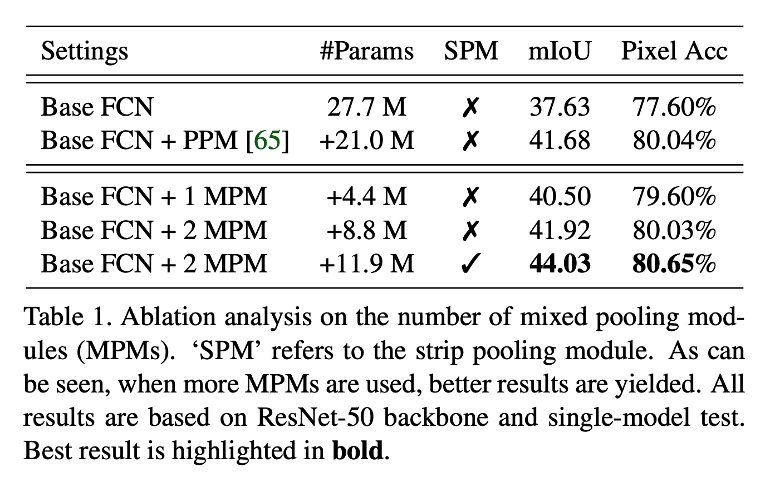
Experiments
Datasets:
Cityscapes
ADE20K
[65] Hengshuang Zhao, Jianping Shi, Xiaojuan Qi, Xiaogang Wang, and Jiaya Jia. Pyramid scene parsing network. In CVPR, 2017.

Slide 7
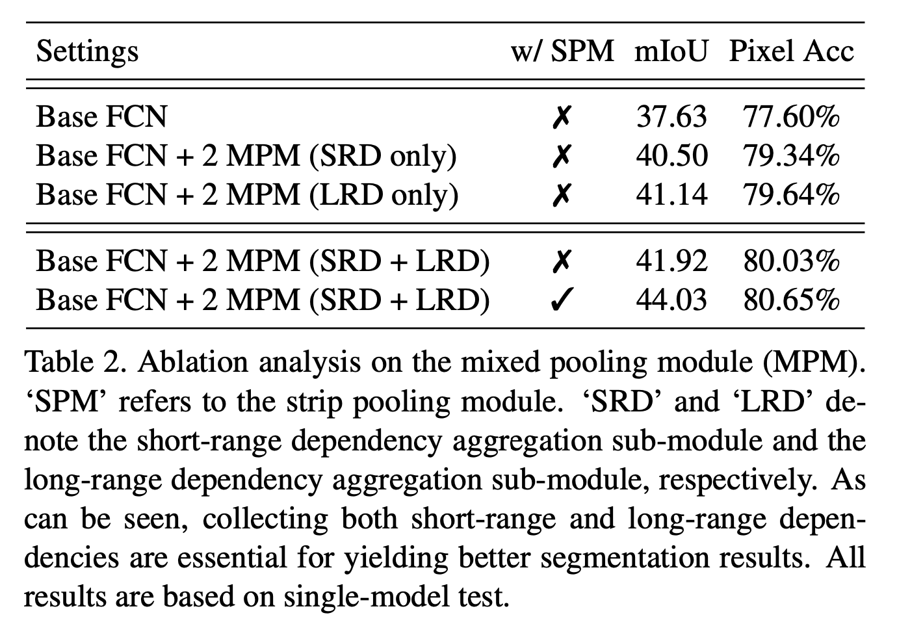
Experiments

Slide 8
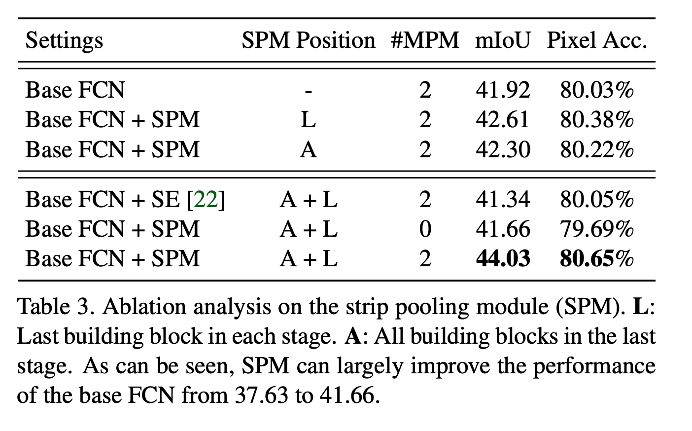
Experiments

Slide 9
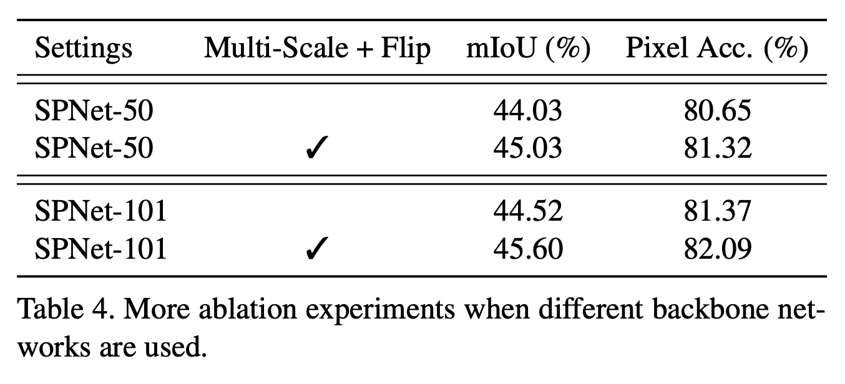
Experiments

Slide 10
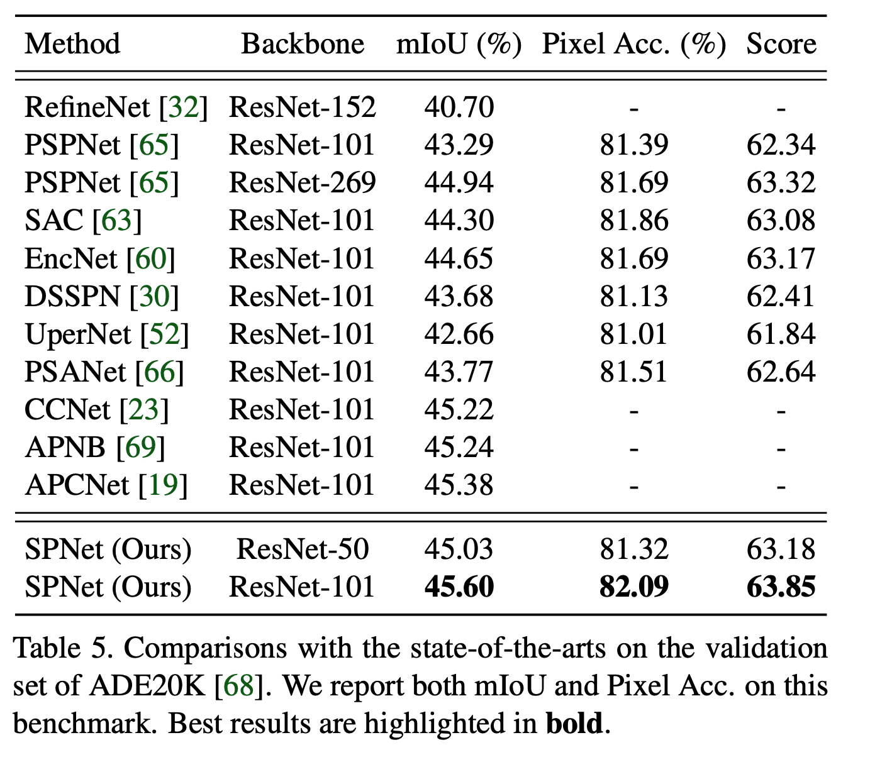
Experiments

Slide 11
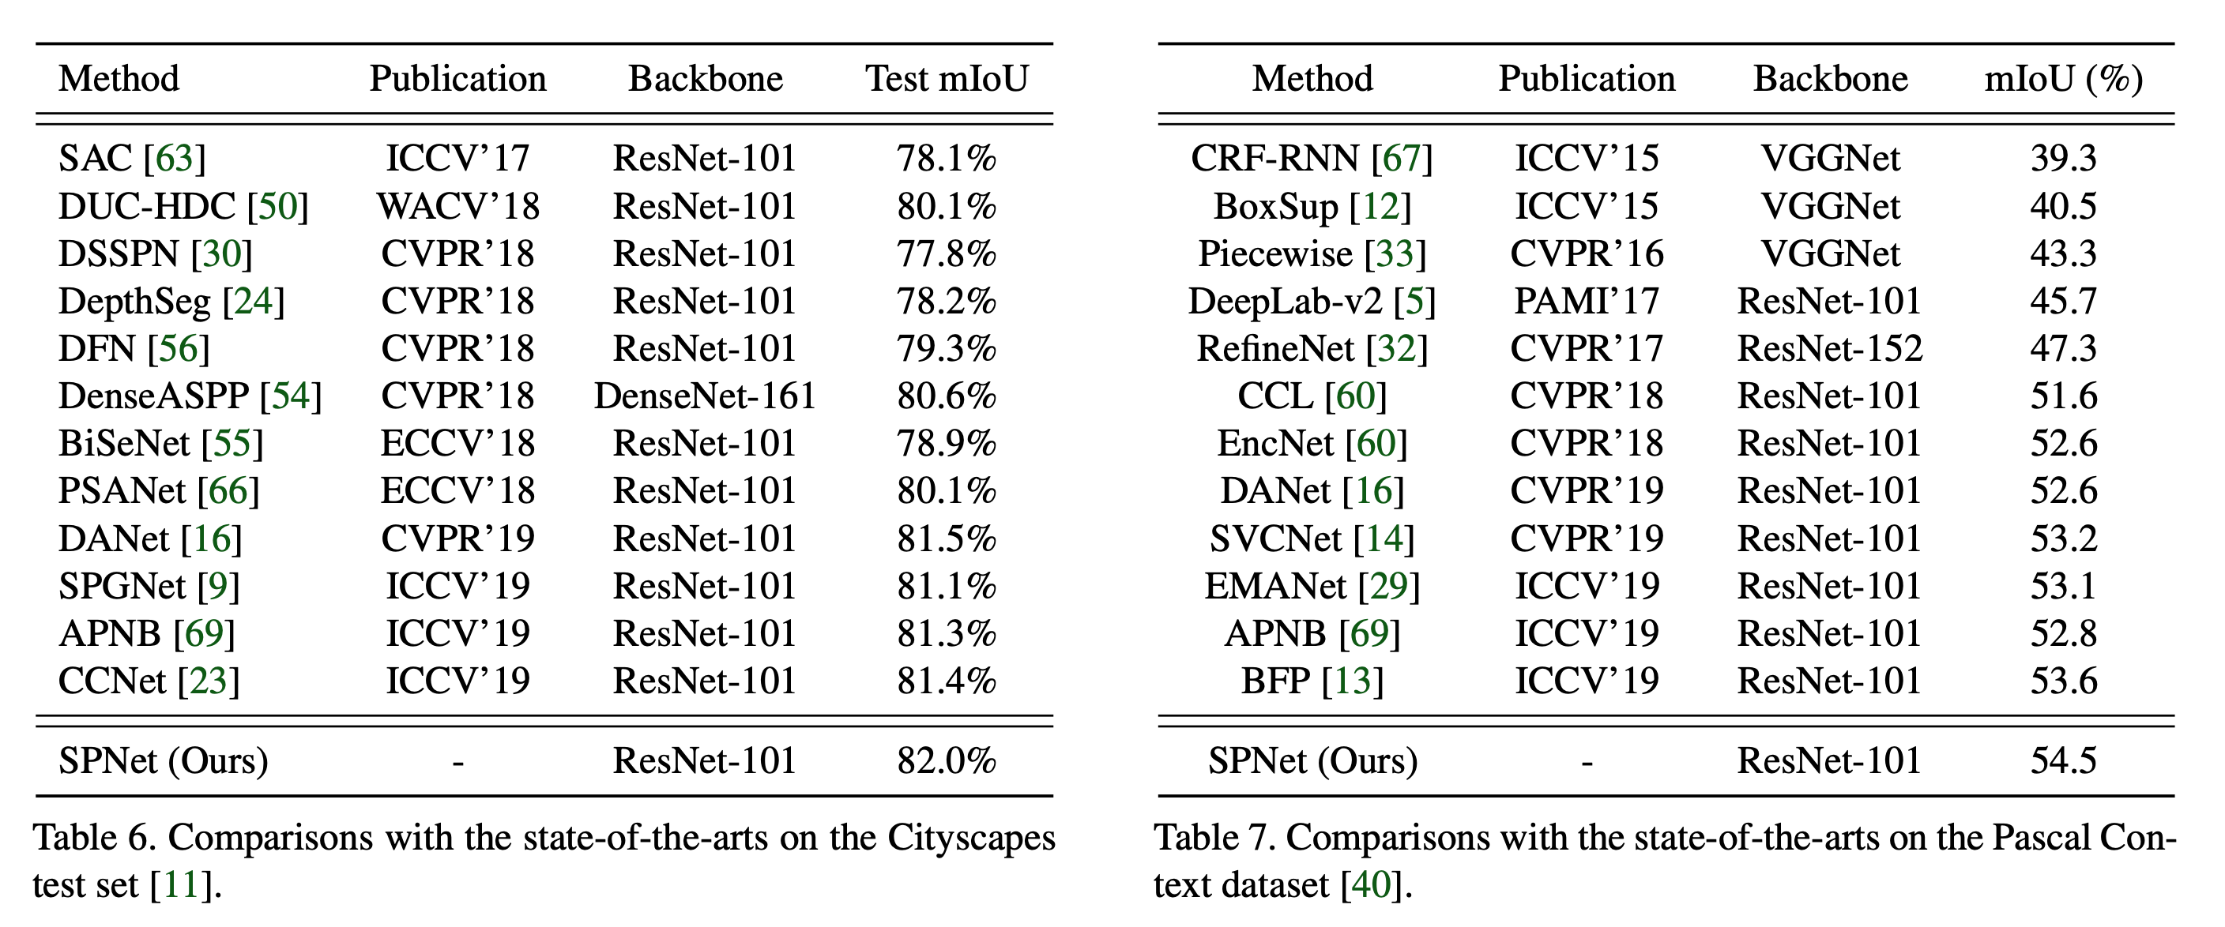
Experiments

Slide 12
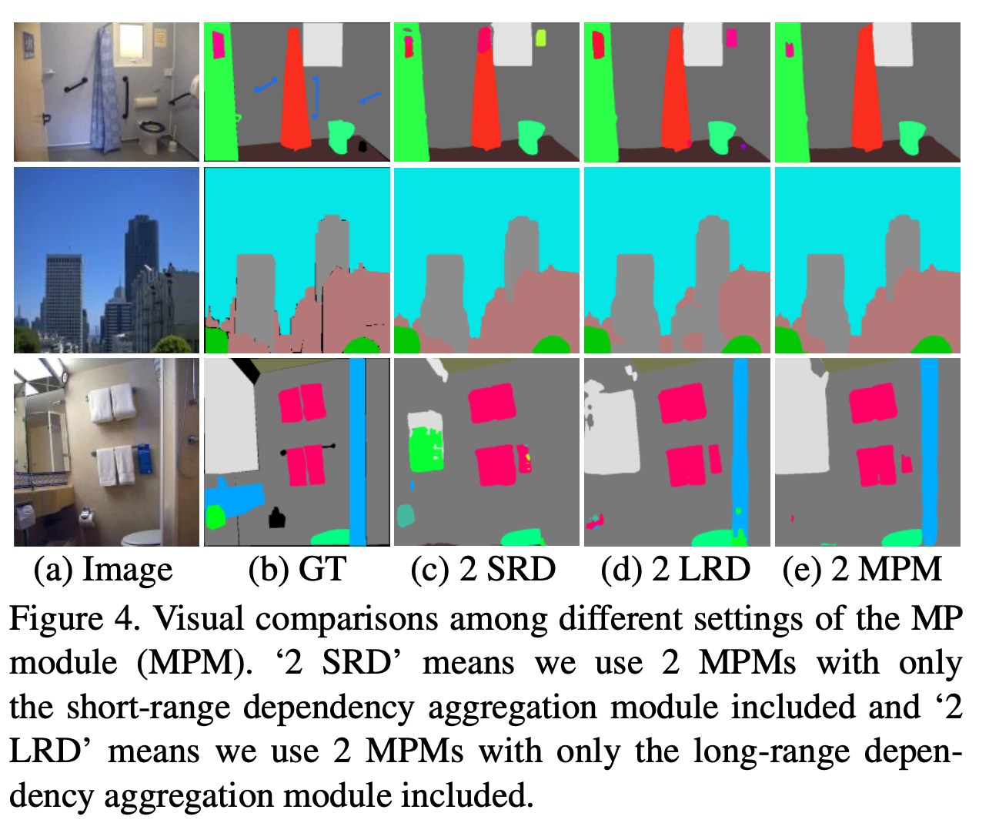
Visual results

Slide 13
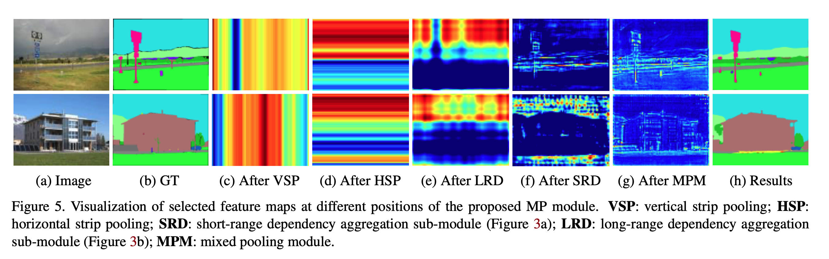
Visual results

Slide 14
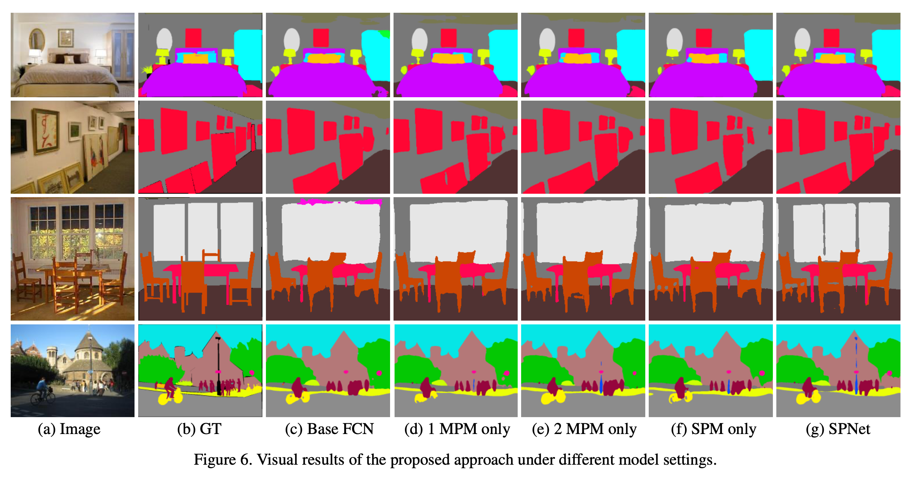
Visual results

